Slide 1
ANALYSING FOR BEST RESTAURANTS
CAPSTONE PROJECT
Presented By:
Sivaramakrishnan E –University college of engineering kanchipuram(UCEK)- Mechanical engineering

Slide 2
OUTLINE
Problem Statement
Proposed System/Solution
System Development Approach
Algorithm & Deployment
Result
Conclusion
Future Scope
References

Slide 3
Problem Statement
This project is to solve the long standing debate of which restaurant is best for middle class peoples ,which would be restaurants which serves quality foods at affordable cost
The project also reveals some of the costly restaurants across the country which would help travellers to avoid unwanted expenses
The project also helps new restaurants owners to determine their dinning price according to the current market prices

Slide 4
Proposed Solution
This analysis will help people to find the best restaurants in an individual states and also helps people to find the state where high sales takes places
Based on distribution of restaurant cost over india will be useful for the young entrepreneur who started new restaurants to fix their restaurant cost
Using the average dinning cost across cities people can find in which cities the dinning cost is high , based on this cost people can find their desired restaurants

Slide 5
System Approach
Building the proposed solution requires combination of data processing ,feature engineering ,data visualization
System requirements:
Hardware requirements:
Processor (CPU):
  A multi-core processor is recommended, especially for handling large datasets and complex computations.
Software requirement :
An os compatable with the project to run it smooth (windows ,mac ,linux)

Slide 6
System approach
Library requirement:
Data processing and analysis:
Pandas
Data visualization:
Matplotlib , seaborn ,scipy

Slide 7
Algorithm & Deployment
Algorithm:
Data Loading: Load the restaurant dataset into a pandas DataFrame.
Data Cleaning: Clean the dataset by handling missing values, removing duplicates, and addressing any inconsistencies or errors in the data.
Data Manipulation: Manipulate the dataset to extract relevant features and create new variables if necessary. For example, you can extract the cuisine type from the meal column, calculate the total votes for each state, or compute the average dining cost for each city.
Data Analysis: Perform exploratory data analysis (EDA) to gain insights into the dataset. This may involve visualizing distributions, correlations, and trends in the data.
Data Visualization: Create visualizations using seaborn or other visualization libraries to present the findings from the analysis. This could include bar plots, histograms, scatter plots, and heatmaps to visualize different aspects of the data.
Conclusion: Draw conclusions based on the analysis and visualization results. Identify patterns, trends, and insights that can inform decision-making.

Slide 8
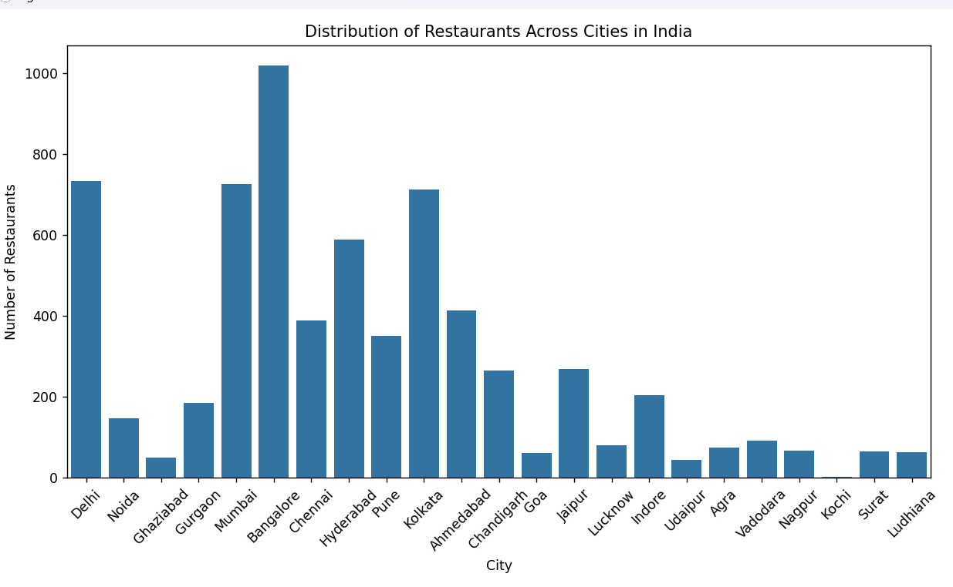
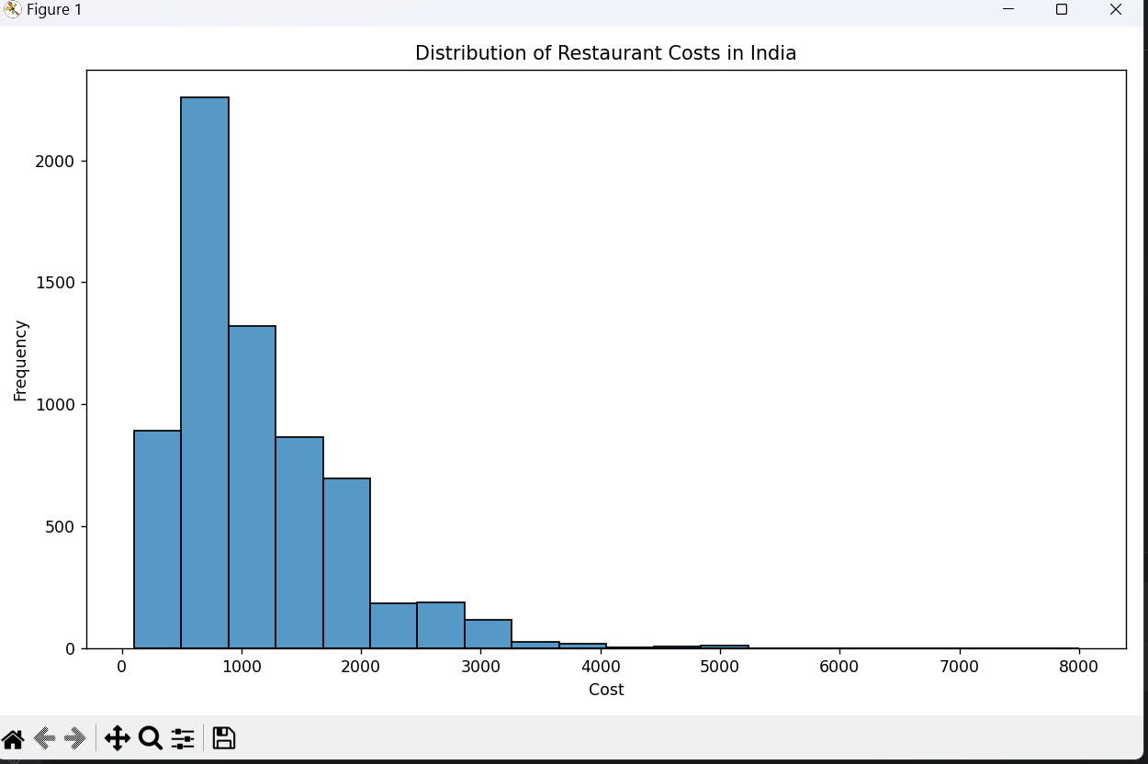
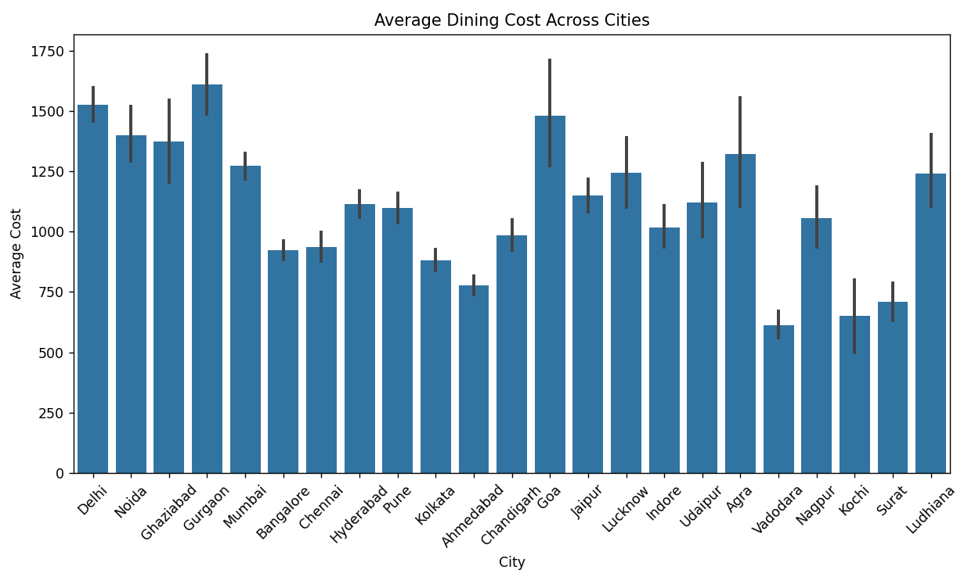
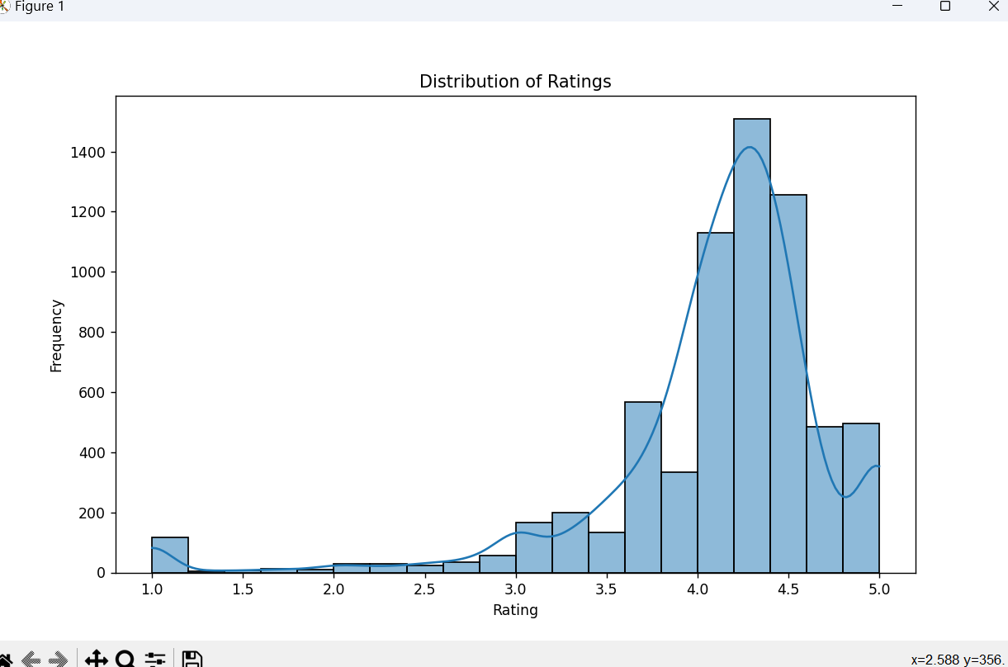
Result

Slide 9
Conclusion
the restaurant data analysis project provides valuable insights into various aspects of the hospitality industry, including cuisine preferences, dining costs, and customer preferences across different cities and states in India. Through thorough data cleaning, manipulation, and analysis, we were able to uncover trends and patterns that can inform strategic decisions for restaurant owners and marketers. The visualization of data using seaborn allowed for clear and intuitive presentation of findings, enabling stakeholders to easily grasp key insights. From the analysis, we observed notable variations in cuisine popularity, dining costs, and customer behavior across different regions, highlighting the importance of localized marketing strategies and menu offerings. Overall, this project demonstrates the power of data-driven decision-making in the restaurant industry and underscores the value of leveraging data analytics tools for informed business decisions.

Slide 10
Future scope
Predictive Analytics: Implementing predictive models to forecast future trends in customer preferences, demand for specific cuisines, and dining costs based on historical data. This could help restaurants optimize menu offerings, pricing strategies, and staffing levels.
Sentiment Analysis: Introducing sentiment analysis techniques to analyze customer reviews and feedback from various online platforms. Understanding customer sentiment can provide valuable insights into areas for improvement and help restaurants enhance customer satisfaction.
Market Segmentation: Further segmentation of the customer base based on demographics, psychographics, and behavior patterns to tailor marketing efforts and menu offerings to specific target segments.

Slide 11
References
Exploring Indian Restaurants Dataset: A Comprehensive EDA on Kaggle | by Arslanr369 | Medium
https://youtu.be/GsfT2sv_zCo?si=cv5rEpL0ux9gIxTK

Slide 12
THANK YOU

